Slide 1




Introduction to Game Demo
Welcome to our Java testing demo! In this presentation, we'll explore the fundamentals of Java testing, including setting up your development environment, leveraging popular testing frameworks, and demonstrating best practices for writing effective unit tests and API endpoint tests.
by phoenix

Slide 2
Set Up
IDE Configuration
Build Tools
Test Runner Setup
We'll start by ensuring your Java development environment is properly configured, including setting up your preferred IDE with the necessary plugins and tools.
We'll also cover the use of build tools like Maven or Gradle to manage your project dependencies and automate the testing process.
Finally, we'll demonstrate how to set up a test runner, such as JUnit or TestNG, to execute your tests and report results.

Slide 3
Overview of Frameworks
JUnit
Mockito
The popular unit testing framework for Java, providing a simple and consistent way to write and run tests.
A mocking framework that allows you to create test doubles, enabling effective isolation of your code under test.
Selenium
Rest Assured
A web automation tool that can be used to write end-to-end tests for your Java web applications.
A domain-specific language for writing readable, maintainable tests for RESTful APIs.

Slide 4
Demonstration of Unit Testing
Test Anatomy
1
We'll examine the structure of a typical unit test, including assertions, setup, and teardown methods.
2
Test Driven Development
We'll showcase how to apply the TDD approach, where tests are written before the production code.
Code Coverage
3
We'll discuss the importance of code coverage metrics and how to measure the effectiveness of your test suite.

Slide 5
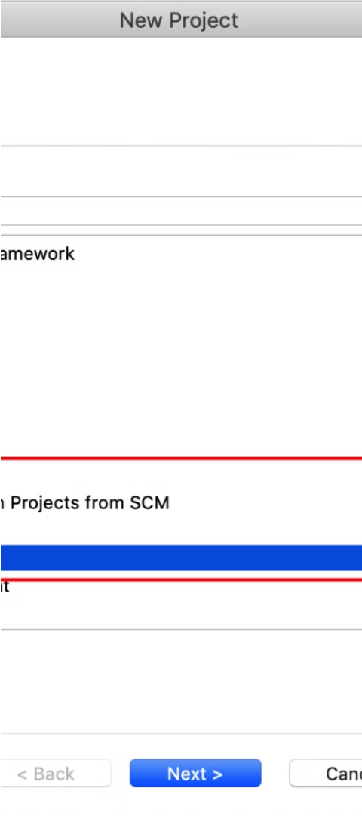



Demonstration of API End Points
REST Assured
We'll use the Rest Assured library to simplify the process of testing RESTful API endpoints.
Endpoint Validation
We'll demonstrate how to validate the response status, headers, and body of your API endpoints.
Data Driven Testing
We'll show how to leverage data-driven testing to efficiently test multiple scenarios for a single endpoint.

Slide 6
Best Practices for Java Testing
1
Modularity
2
Readability
Write tests that are independent and self-contained, allowing for easier maintenance and troubleshooting.
Ensure your tests are well-named and provide clear, human-readable documentation.
3
Continuous Integration
4
Maintainability
Integrate your testing workflow into a CI/CD pipeline to catch issues early and ensure consistent results.
Design your tests to be resilient to changes in the production code, minimizing the need for constant updates.

Slide 7

Conclusion and Q&A
In this presentation, we've covered the essential aspects of Java testing, including setting up your development environment, leveraging popular testing frameworks, and demonstrating best practices for writing effective unit tests and API endpoint tests. We hope this has provided a solid foundation for your Java testing journey. Now, let's open the floor to any questions you may have!

